Slide 1
Why Does My Computer Do That? Intro to Coding with Python– Functions
Dr. Ab Mosca (they/them)
Slides based off slides courtesy of Jordan Crouser (https://jcrouser.github.io/)

Slide 2
Plan for Today
basic components
definition vs. call
an analogy
parameters
returning values

Slide 3
Functions
Recall: a function is a procedure / routine that takes in some input and does something with it (just like in math)
We’ve seen lots of built-in functions:
print(…)
input(…)
eval(…)
round(…)
Perhaps unsurprisingly, Python lets us write custom functions as well (like the main() function)

Slide 4
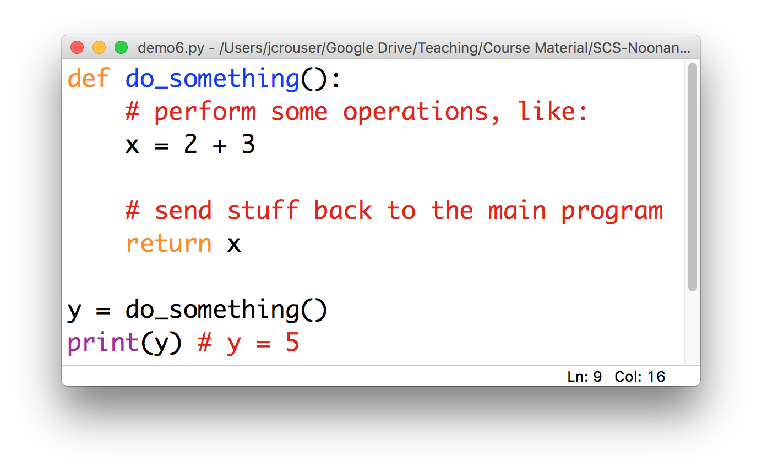
Basic components of a function

Slide 5
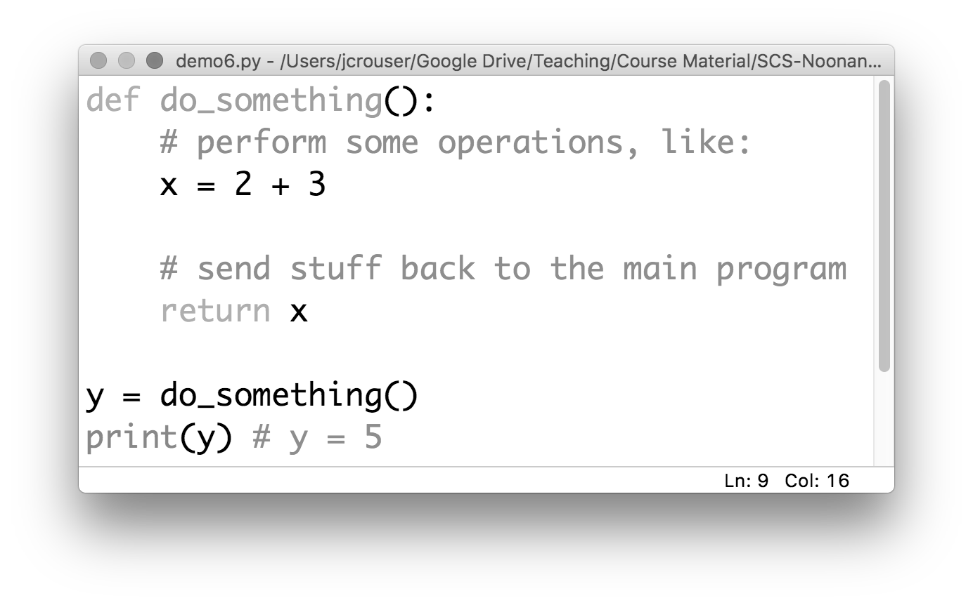
Basic components of a function
a name
Convention: use _underscores_ or camelCase

Slide 6
Basic components of a function
which is defined
using the def keyword

Slide 7
Basic components of a function
a body
(indented)

Slide 8
Basic components of a function
a return (optional)

Slide 9
A “function definition”

Slide 10
Discussion
What happens if we run this program?

Slide 11
A “function definition” is a description
(but not a directive)

Slide 12
Function calls: “hey, Python! do this”
a function call

Slide 13
Function calls: “hey, Python! do this”
5

Slide 14
An analogy
functions are your MINIONS

Slide 15
An analogy
functions have NAMES

Slide 16
An analogy
they only work when you CALL them

Slide 17
An analogy
main()
functions
can be
called by
main()
stuart()

Slide 18
An analogy
main()
functions
can also be
called by
one another
stuart()
jerry()

Slide 19
Two kinds of functions
Some functions always do the same thing

Slide 20
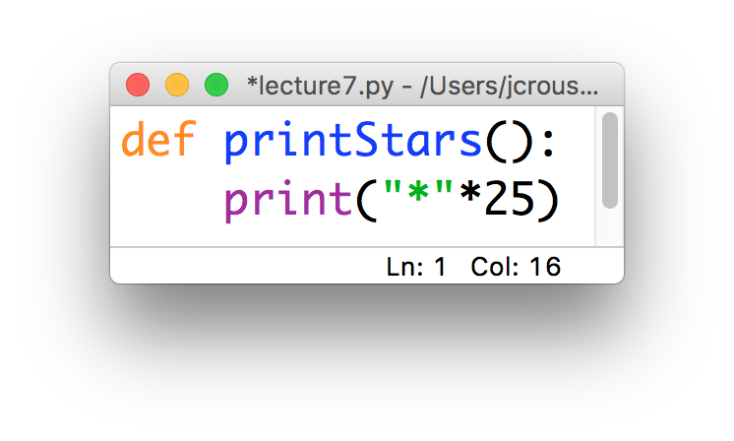
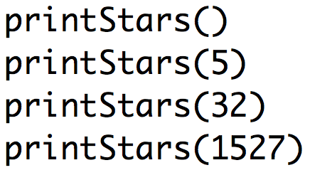
Two kinds of functions
Some functions always do the same thing

Slide 21
Two kinds of functions
Some functions always do the same thing
Others adjust their behavior based on what we give them

Slide 22
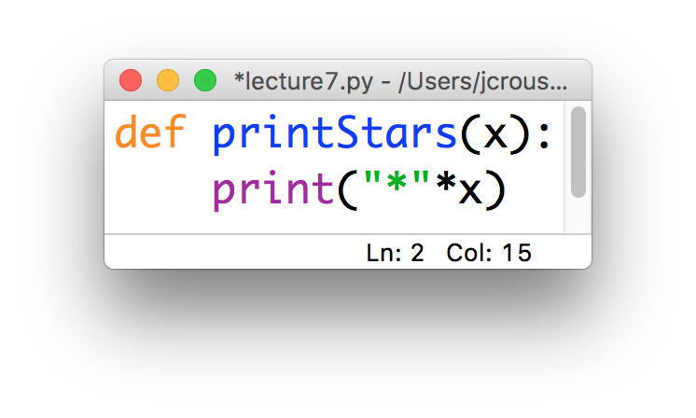
Two kinds of functions
Some functions always do the same thing
Others adjust their behavior based on what we give them

Slide 23
Two kinds of functions
Some functions always do the same thing
Others adjust their behavior based on what we give them
“parameter”

Slide 24
Two kinds of functions
Some functions always do the same thing
Others adjust their behavior based on what we give them
“parameter”

Slide 25
15-minute exercise: Happy Birthday
Write a function called happyBirthday(name) that takes in a string name and prints out the lyrics to the song ”Happy Birthday” with the name inserted:
Happy birthday to you!
Happy birthday to you!
Happy birthday, dear NAME
Happy birthday to you!
Call this function from inside the main() function, and use input(…) to get the value of name from the user

Slide 26
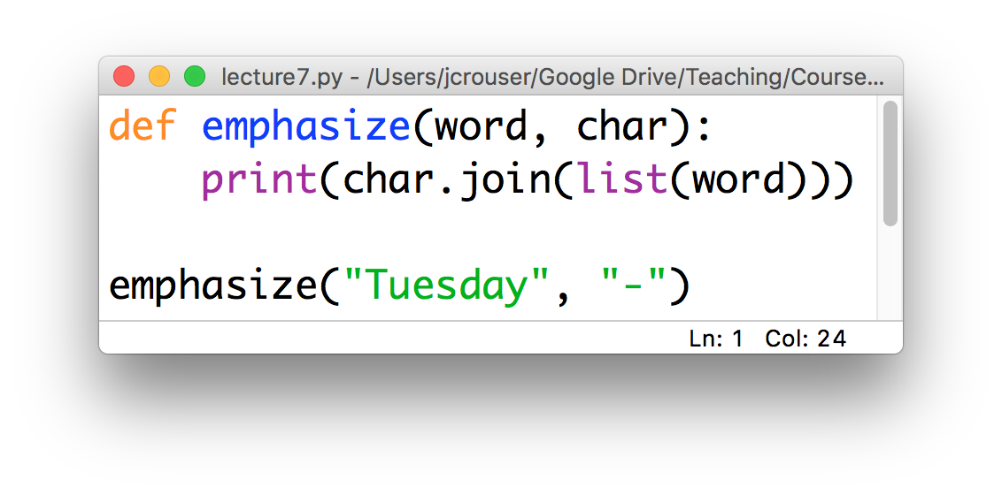
Parameters
Functions can be defined to take in multiple parameters:
Result:
T-u-e-s-d-a-y
char = “-”
word = “Tuesday”

Slide 27
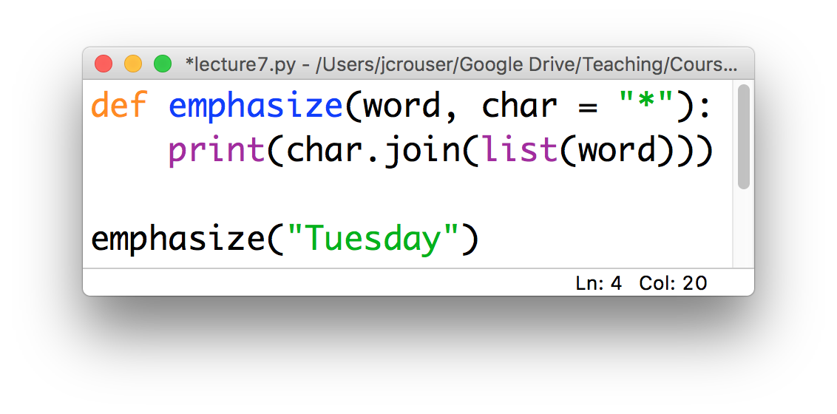
Default parameters
We can include a “default” value for some (or all) of them:
Result:
T*u*e*s*d*a*y
only one parameter

Slide 28
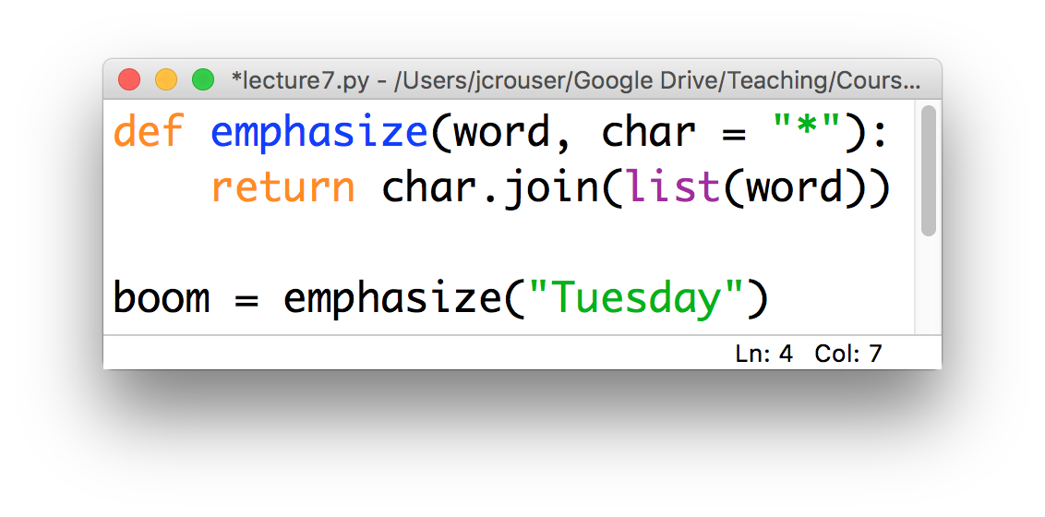
Returning values
We may want to return the results rather than print them:
the results of the return in
emphasize() are stored in boom

Slide 29
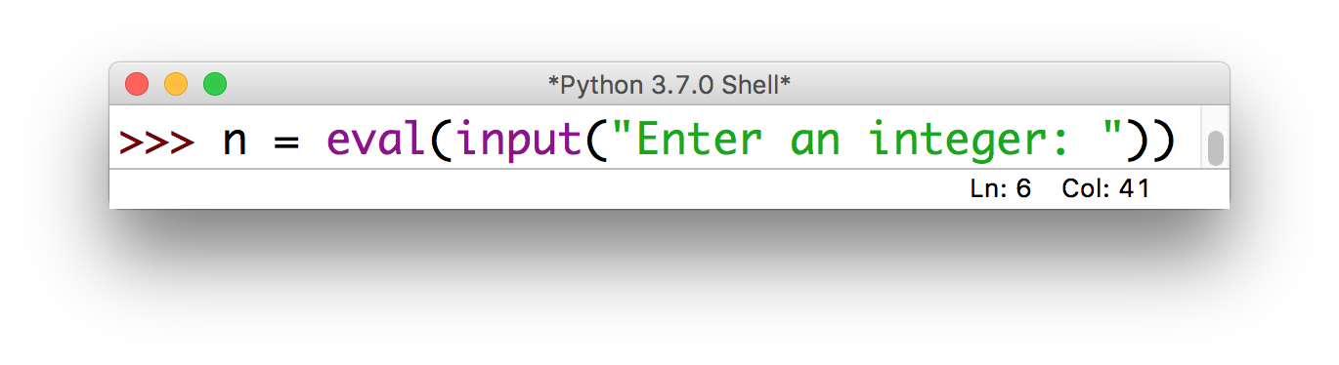
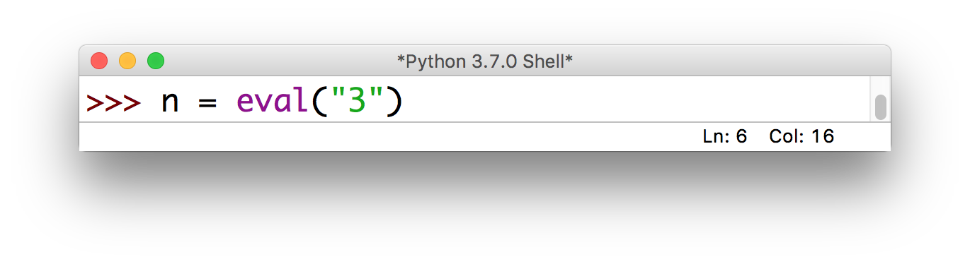
Advanced: chaining functions
Return values allow us to call functions inside other function calls:

Slide 30
Recap: functions
If you have to do something multiple times, then you probably want a function: this helps to “modularize” code (i.e. organize it for easy reuse)
Define once, call as many times as necessary
Naming convention: use camelCase
Important: one function = one task

